Slide 1
JAMIE DOMM – JDIM.digital
How to Build a Strong Digital Strategy
for your personal or church ministry

Slide 2
Today's Discussion
The Role of Leadership
Establishing Your Brand
Setting Goals
Determining Key Performance Indicators
Matching Platforms to Your Audience
Developing An Integrative Communications Strategy
Best Practices for Digital Communications
Q&A

Slide 3
It is imperative that we become just as effective as secular organizations and celebrity influencers at using digital media for communication and community building

Slide 4
FACING CRITICISM TO CHANGE
a matter of good stewardship.
Christ is our Rock & Foundation

Slide 5
As leaders you can:
Include digital strategies in short- and long-term visions and goals.
Dedicate funds for social media promotions.
Dedicate time for training you and your team members.
Identify people who could take on social media as part of their ministry duties (this may mean taking something else off their plate).
Invest in young people; give them space to utilize their skills in this area for the Church.
Get out of the way and let innovation happen.
Take advantage of all the free resources, classes, and case studies on SDAdata.org or get the Digital Discipleship & Evangelism book at JDIM.digital/book
THe Role of Leadership

Slide 6
BRANDING FOR MINISTRIES
How do you want
to be known?

Slide 7
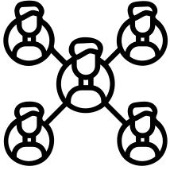
MARKETING
PUBLIC RELATIONS
CORPORATE COMM
Path of Creativity
[OUTREACH]
Examples: @gorgeous2god, @angelsintheglen, @humansofadventism
name connects to mission & vision.
Keyword Theme
Blends [OUTREACH & INREACH]
Example: @enditnowNAD or @godhasgiventruly for Justin Khoe
encourage community awareness & influence
Organization Name
[INREACH]
Example: @NADadventist
internal audience for official statements, policies, beliefs, etc.
BRAND NAME OR SOCIAL MEDIA HANDLE
@NAME

Slide 8
promote awareness
foster emotional connectedness
You're Branding Should
communicate your mission & value (brand story)
encourage brand ambassadors
Your brand strategy and digital strategy work together and are part of a grand communications strategy.
shape expectations for those you serve (brand promise)
provide strategic direction to you and your team and set clear goals/objectives (mission/vision)

Slide 9
Brand: represented by its logo, its color, its typefaces, its images, its designs, its tone of voice, and its customer service
Brand Strategy: defines the organization’s central message and how to say it
BRAND BASICS
Brand Guidelines: a system of managing the brand visually
Shape your brand
and communications
around your purpose

Slide 10
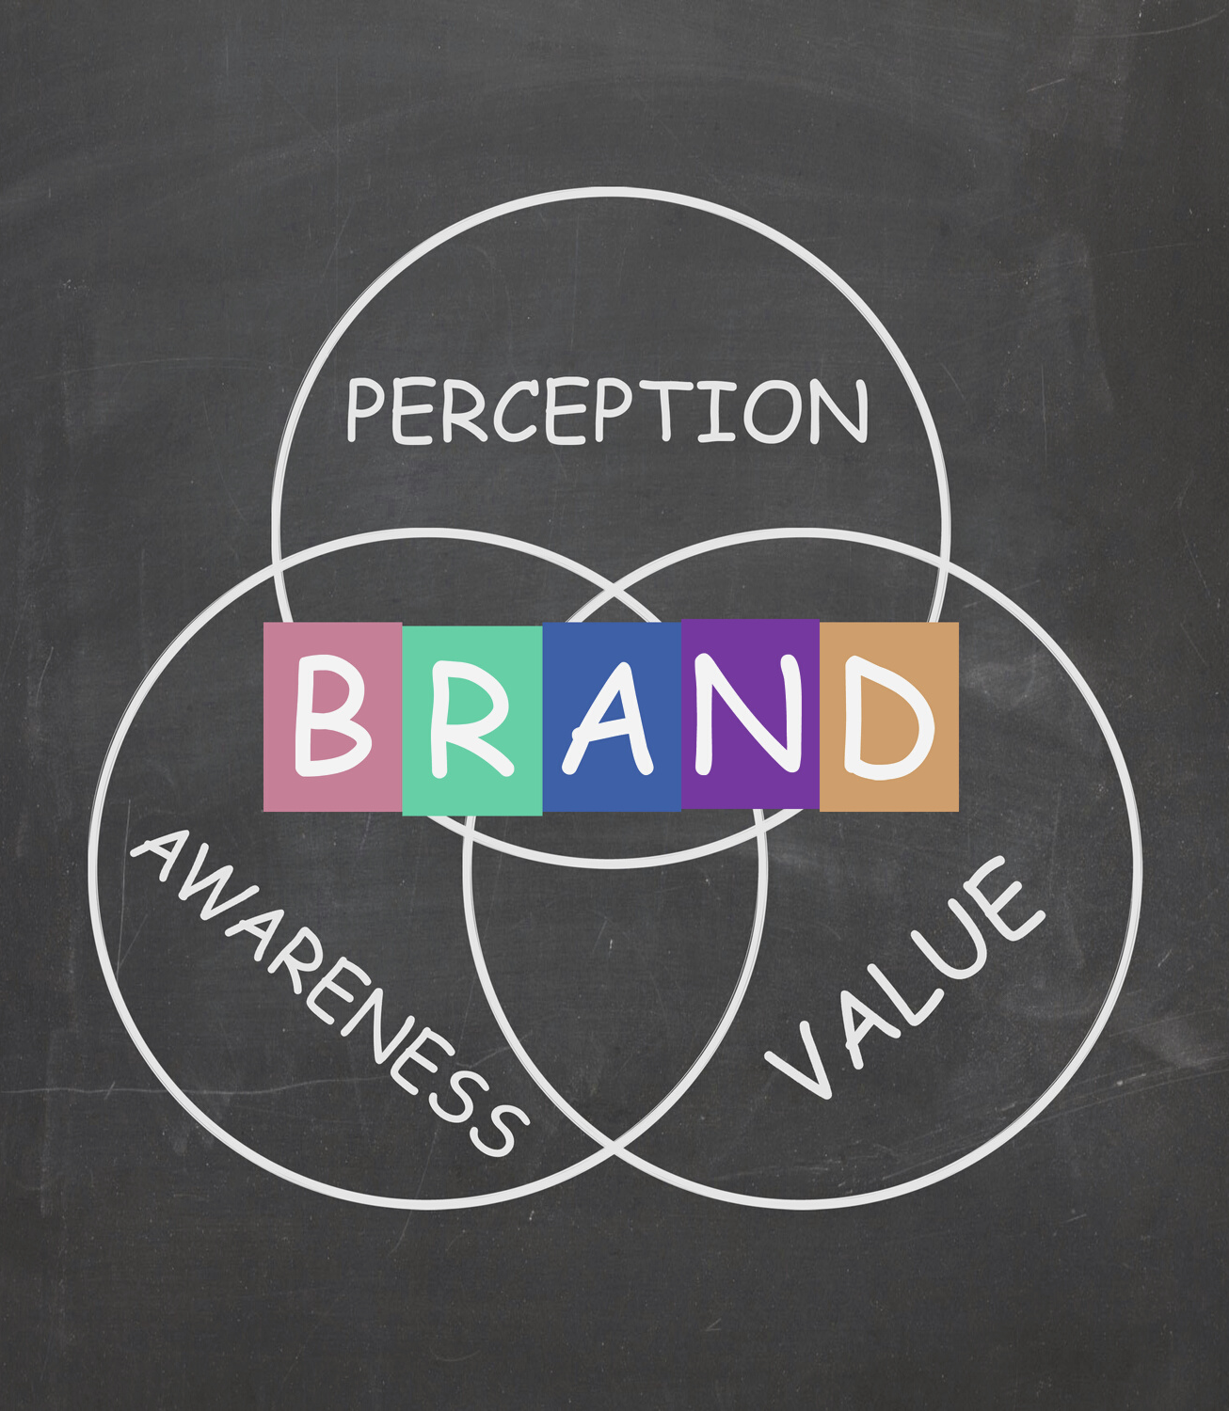
BE CONSISTENT
Whether you're starting from scratch or rebranding, choose a website domain and handle that matches your ministry's name and mission to reinforce your brand across multiple channels and touchpoints.

Slide 11
BE SURE TO:
Reserve your name on all platforms.
Use a consistent name (15 characters or less; short/simple; stands test of time; no numbers, symbols, or punctuation).
Use the same profile photo & a consistent design look.
Use the same headline, blurb, or bio.
Develop a consistent voice/tone.
Clearly articulate what you do and offer through your mission, brand promise, and brand story.
Establishing your brand

Slide 12
Your digital presence is an extension
of your ministry’s brand and voice into
the online world. Your brand is how you
are perceived.

Slide 13
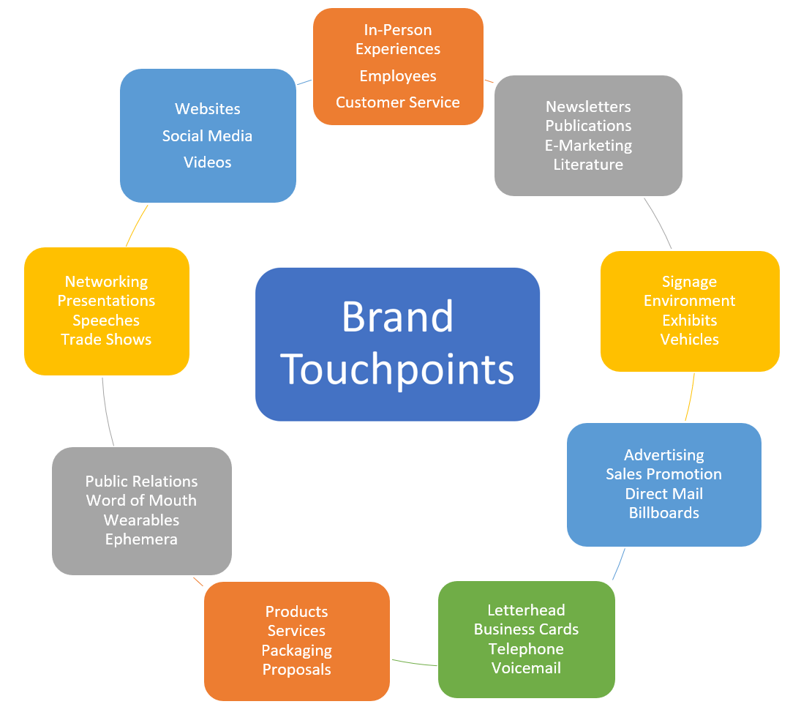
Tell one consistent story
HAVE A PLAN FOR EVERY PART OF THE SEEKER'S JOURNEY
Strong digital brands create connections with real people and take a comprehensive approach to the member experience.

Slide 14
BRANDING FOR MINISTRY
SDAdata.org/digital-evangelism-blog/branding-for-ministry
STORY BRANDING 2.0 BOOK
amzn.to/3k4tsmK
Resources
KNOWEM.COM
Check availablity of potential names.
GODADDY.COM
Check availability of potential domains.

Slide 15
DEFINE YOUR PURPOSE FOR GOING DIGITAL
Then frame your strategy accordingly.

Slide 16
Understanding Purpose
Develop clear objectives for your digital communications, such as:
to advance the gospel message among at-risk youth and positively influence your community through content that seeks to uplift and inspire them in the face of everyday challenges.

Slide 17
STRONG FOUNDATION
Brand + Purpose + Goals

Slide 18
Examples of Goals
Increase fan base and drive traffic to your website, podcast or YouTube channel.
Increase event attendance & participation.
Increase community awareness to become more than just a Christian contact.
Get to know your community better and understand their felt needs.
Encourage social media ambassadors to share your content and invite people to your live events/programs.
Increase meaningful engagement online.
Become a digital disciple who actively shares their faith in the digital space.
Reach target groups with meaningful content that will address a felt need.
Improve the lives of others.
Communicate core Christian values to the “unchurched”.
Create connection and foster relationships among non-Christians.
Define what it means to be a Christian, becoming a resource to the community.
Set expectations, both for those who interact with you and for you.

Slide 19
Create clarity
and focus
When you and your team understands what they are trying to achieve, it enables them to find their place within your unified mission.

Slide 20
EVALUTATING YOUR EFFECTIVENESS
Performance Metrics

Slide 21
Types of Metrics:
Activity metrics: quantity of posts and content created (a great metric for beginners who are starting a content strategy from scratch)
Reach metrics: number of people who see your content and their demographic data
Engagement metrics: interactions and interest in your brand and content
Acquisition metrics: changes in engagement over time or “relationships developed”
Conversion metrics: actions, sales, registrations, resource requests, and other results
Retention metrics: happy “customers” and brand evangelists

Slide 22
Limited time?
SET BENCHMARKS
Track high-level numbers

Slide 23
ACTIVITY METRICS:
ACQUISITION METRICS:
number of videos/podcasts/new content created by the team
empowerment of social media ambassadors and the resulting activity, number of questions submitted, active online Bible studies, Bible study requests, or active (ongoing) conversations
REACH METRICS:
CONVERSION METRICS:
reach/impressions/views for your content in general or from a specific age group, location, or people group. Also, traffic to the website/channel in general or from a specific channel, platform, or location.
number of volunteers, registration numbers, event attendance, donations, visits to your ministry’s physical location, quantity of purchases, baptisms, one-on-one meetings, as well as book, Bible study, and resource requests
Key performance indicators
ENGAGEMENT METRICS:
RETENTION METRICS:
quantity of followers, likes, shares, comments, or messages
testimonials, repeated visitors to your physical location, positive impressions shared, people sharing their experience with their online friends/followers, meeting felt needs, developing a presence in the community, increased involvement in your ministry

Slide 24
Establish Brand
Define Purpose
Set Goals
Choose Metrics
WHAT'S NEXT?
Understanding Your Audience Guide: JDIM.digital/publications

Slide 25
MATCHING PLATFORMS TO YOUR AUDIENCE
Remember, to reach your target audience, you must go to where they spend their time online and use the language they use.

Slide 26
DON'T GET OVERWHELMED
Pick a few platforms and utilize them well
Start small

Slide 27
Platform Summaries
understanding where your audience spends their time

Slide 28
FACEBOOK
INSTAGRAM
TWITTER
70% of Americans (spans all ages)
skews older
highly interactive
great for community building
*most churches should start here*
65% between ages 18-34
72% of teens use it
highly visual (pics & short clips)
not as engaging but great for creatives
*recommended for young audiences*
68% between ages 18-49
skews male
micro-blogging platform
great for conversations on trending topics
*recommended for cause-based ministries*
Platform Highlights

Slide 29
SNAPCHAT
TIKTOK
YOUTUBE
90% between ages 13-24
brief, 10 second interactions
content disappears
geofilters are great for live events
(brand awareness)
*potential for building relationships
with local youth*
50% under age 34
viral video app
creators share bit-sized videos
music, dance, remix, challenges, editing features, & collaborative features
*ideal for creative ministry content*
second largest search engine
primarily used for learning & entertainment
great for repurposing video content to be evergreen and findable
*recommended for churches who stream*
Platform Highlights

Slide 31
Thinking Integratively
TRADITIONAL + DIGITAL
working together to maximize impact

Slide 32
Truly effective communication strategies work across all channels and platforms to reach people where they are, conveying one consistent goal or message.

Slide 33
REMEMBER THE
Rule of 7

Slide 34
Rule of 7 Defined
A person needs to be exposed to a message at least seven times before they’ll take a desired action.

Slide 35
CHANNEL
refers to the communication medium, such as radio, print, TV, text messages, websites, or social media
PLATFORM
refers to different kinds of social media such as Facebook, Snapchat, YouTube, and Instagram

Slide 36
Effective communication strategies work across all channels and platforms to reach people where they are, conveying one consistent goal or message.
INDIVIDUALS CAN LEVERAGE:
in-person interactions and conversations
website updates
text messages
flyers
group messaging tools
emails
your social media profiles
Notes:
Often times as individuals, we think saying something once is enough and any more than that is overkill, when in reality, people are busy, they forget, over-communication is necessary in this busy world. You can give the same message many different ways without being overbearing. Just be sure to space out your communications and follow up messages.

Slide 37
GET ORGANIZED!
To be successful, you'll have to plan & organize across all your communication channels

Slide 38
DETERMINE ROLES and/or CONTENT NEEDS
divide responsibilities if you are lucky to have a team. Take time to plan out your content strategy and types of content needed.
Tips For Organization
DEVELOP A CONTENT CALENDAR
that enables you to plan across all channels and platforms.
FREE content planning calendar: JDIM.digital/post/contentcalendar
SHARE THE CALENDAR
with your entire communications team. We recommend using Google sheets.
SCHEDULE POSTS
in advance for increased flexibility.

Slide 39
Develop your brand
Define your purpose
Set goals
Establish performance metrics
Choose your platforms
Develop an integrative communications plan
Get organized
Review of The Process

Slide 40
NEXT
Utilize Best Practices

Slide 41
Batch Create & Schedule Content
PLAN AHEAD
then focus your engagement, community building, distribution, data analysis and strategic planning
Templates: JDIM.digital/post/contentcalendar

Slide 42
Keep it interesting
USE A DIVERSITY OF CONTENT
keeps audience engaged and reaches a broader groups of people

Slide 43
Follow the 20/80 rule
FIND THE RIGHT BALANCE
80% engagement
20% direct appeals

Slide 44
Commit to posting frequently
QUALITY > QUANTITY

Slide 45
Write for your audience
FOLLOW THE PRINCIPLES
for a strong social media posts and visuals.
Tips for Creating Strong Social Media Posts: JDIM.digital/publications

Slide 46
Tag other accounts
PARTNERSHIPS BENEFIT EVERYONE
It's also a great way to expand the reach of your content.

Slide 47
Always link back to your website
MAKE IT EASY FOR THEM TO FIND OUT MORE & TAKE ACTION

Slide 48
Promote your social media
BUILD OUT FROM YOUR CONTACTS
Leverage your friends and followers as a reach vehicle for souls. They all have influence, ask them to use it.

Slide 49
Engage in comments
EVERY OPPORTUNITIY TO CONNECT IS AN OPPORTUNITY TO GROW THE KINGDOM OF GOD

Slide 50
Don't give up too soon! Post reach and interaction will ebb and flow based on your audience’s personal preferences, attitude of the day, the news, that evening’s supper, or just the busyness of life. Keep posting. Keep interacting. Keep adapting.

Slide 51
Share the book!
PRINT & DIGITAL AVAILABLE
AdventSource & Amazon
Learn more:
JDIM.digital/book
Contact me: JDIM.digital
Digital Ministry: angelsintheglen.org

Slide 52
Q&A

